Slide 1

UTSA Datathon 2024
ANALYSIS OF MONARCH BUTTERFLY MIGRATION
COMPARED TO PESTICIDE CONCENTRATION BY STATE
TEAM THE FANNYPACK
RYAN BERBEREK, EFRAIN GARZA, LAUREN HOCHMAN, LA MIA PRUITT

Slide 2

OBJECTIVE
We were tasked with responding to a global crisis. Over the past year, there has been a precipitous decline in pollinator populations worldwide. Our responsibility was to select and analyze relevant data, interpret our findings, and recommend a strategy. Our group has been assigned to focus on monarch butterflies.
Our team discovered basic insights on the decline of the monarch butterfly population by cleaning, preparing, analyzing, and visualizing pesticides and sightings.

Slide 3
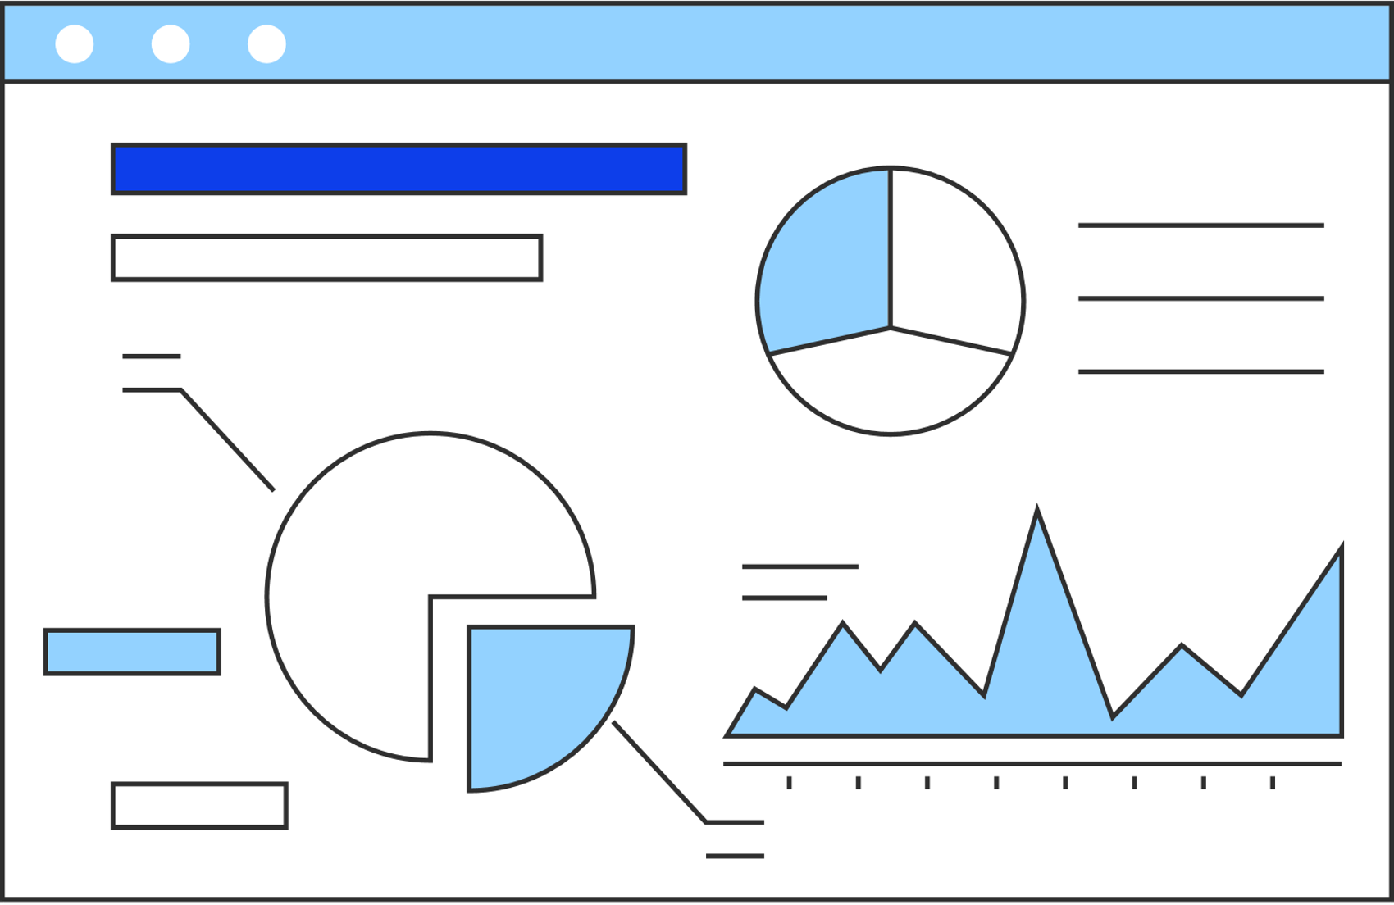
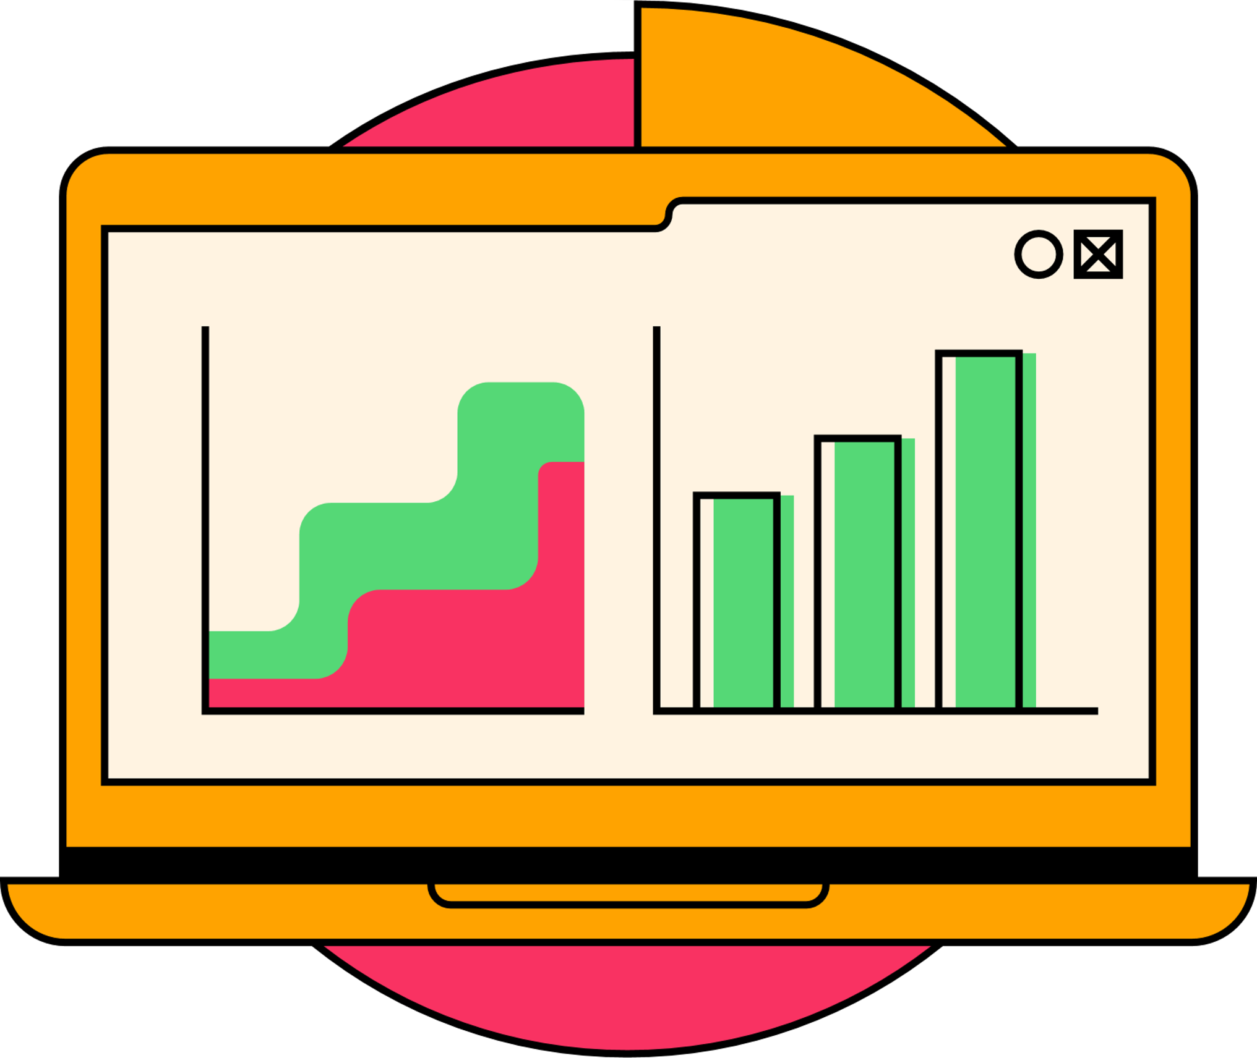
PROPOSAL
PROPOSAL
With full transparency in mind, our team would like to note that we did not complete a time series analysis. We focused on the summation of the concentration of pesticides per state instead of the highest concentration per state. We propose future analyses to be made on the datasets that we prepared.
METHODS
Datasets: USDA Pesticide Data Program, Journey North Monarch Butterfly
Data cleaning and conversion for future analysis
Software: Excel, SAS, Python, Access, Tableau
Tables and graphs: Pivot table, density map

Slide 4
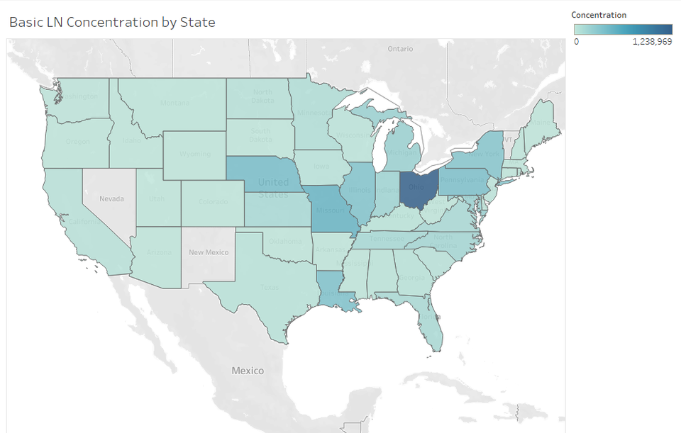
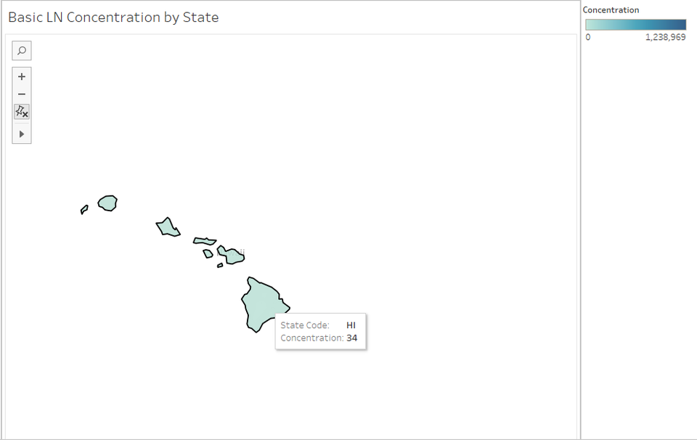
ANALYSIS
Summation of Pesticide Concentration by State

Slide 5
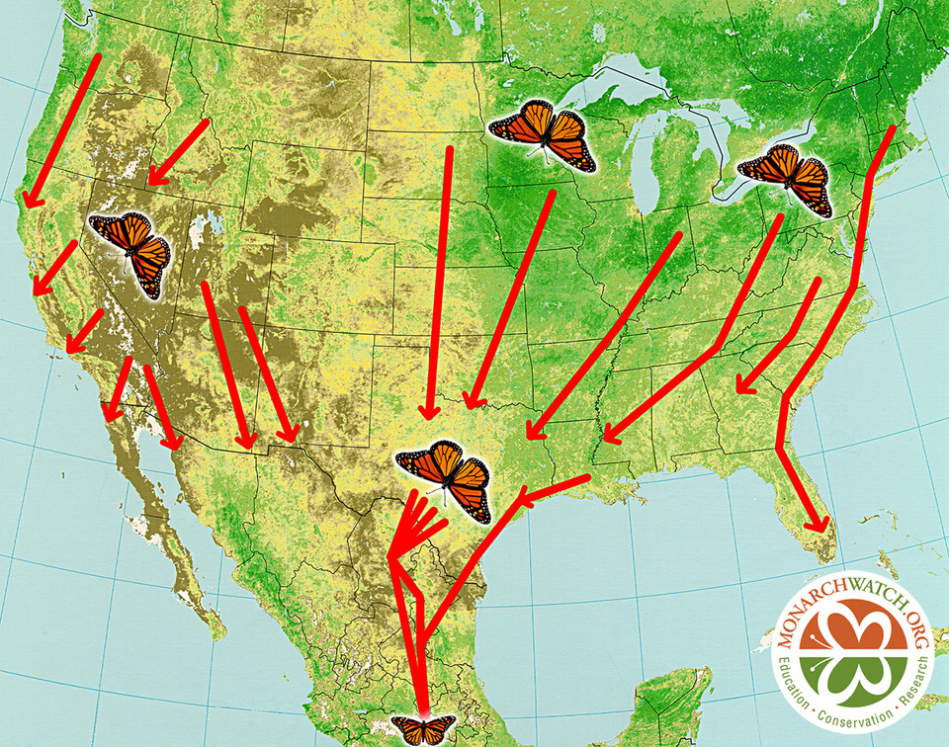
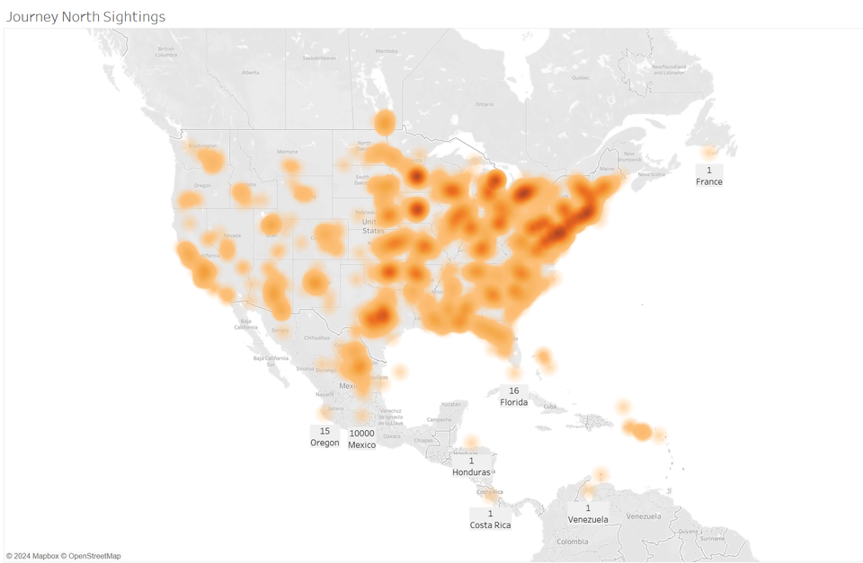
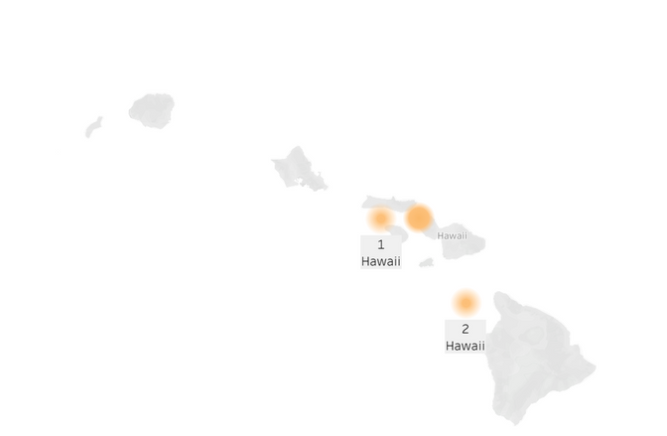
ANALYSIS
Fall Monarch Migration Heat Map
Source: Monarch Watch
https://news.illinois.edu/view/6367/474116
*No data provided for Alaska
We acknowledge that this data was collected by citizen data reporters. Please understand the implications of human error and bias on the heat map.

Slide 6
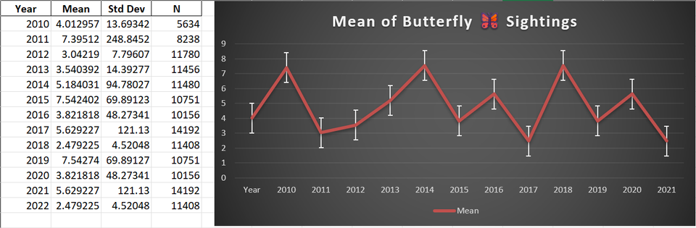
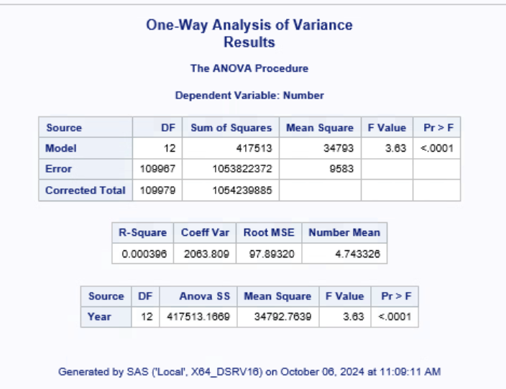
CONCLUSION
We prepared the data for future time series analysis, which will give us a better idea of areas that have the highest concentration of pesticides. We are interested in the higher concentration levels as time progresses among the states and possibly the city level.
The one-way ANOVA shows a significant difference in butterfly sightings across years (p < 0.0001), and the plot reveals a declining trend in recent years.

Slide 7
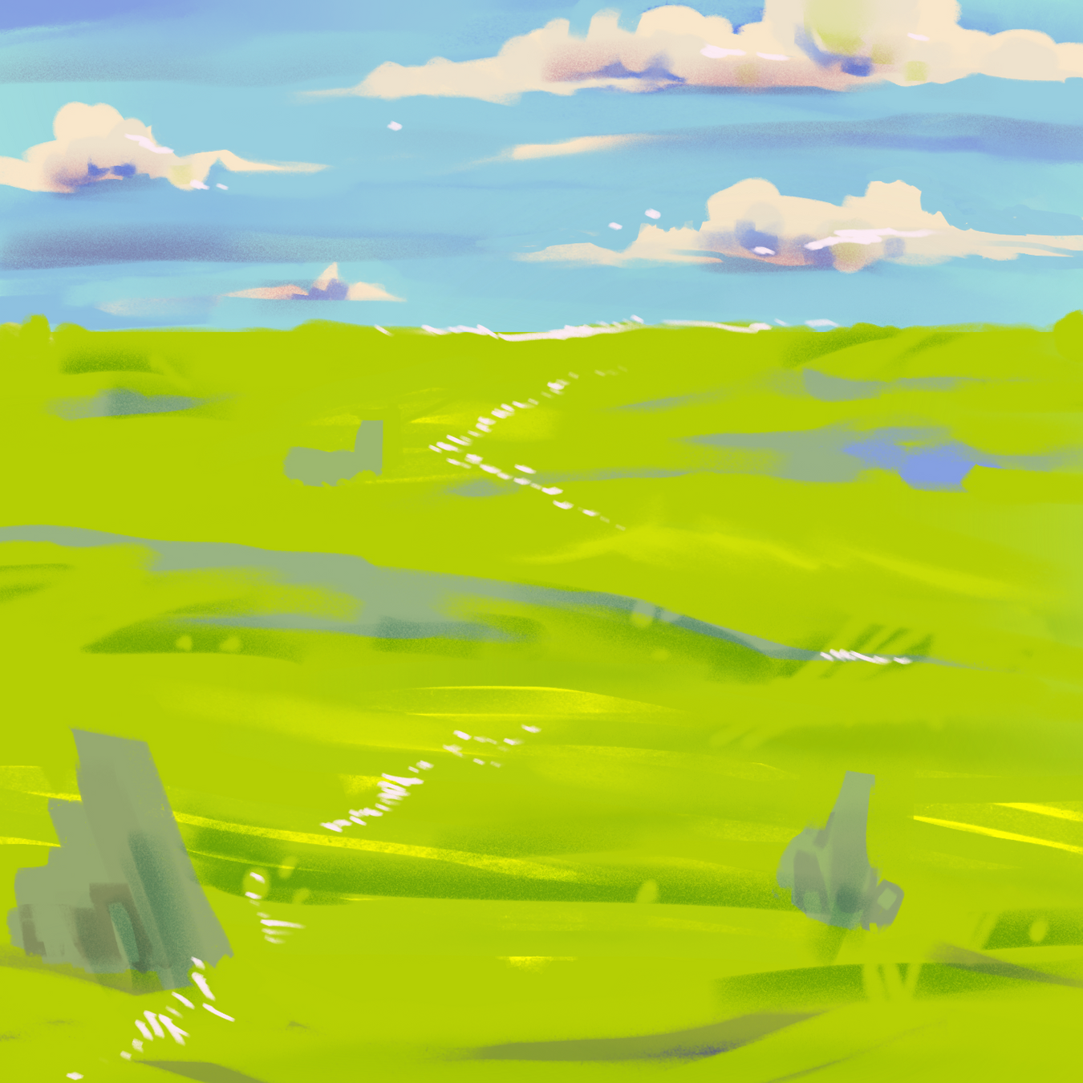
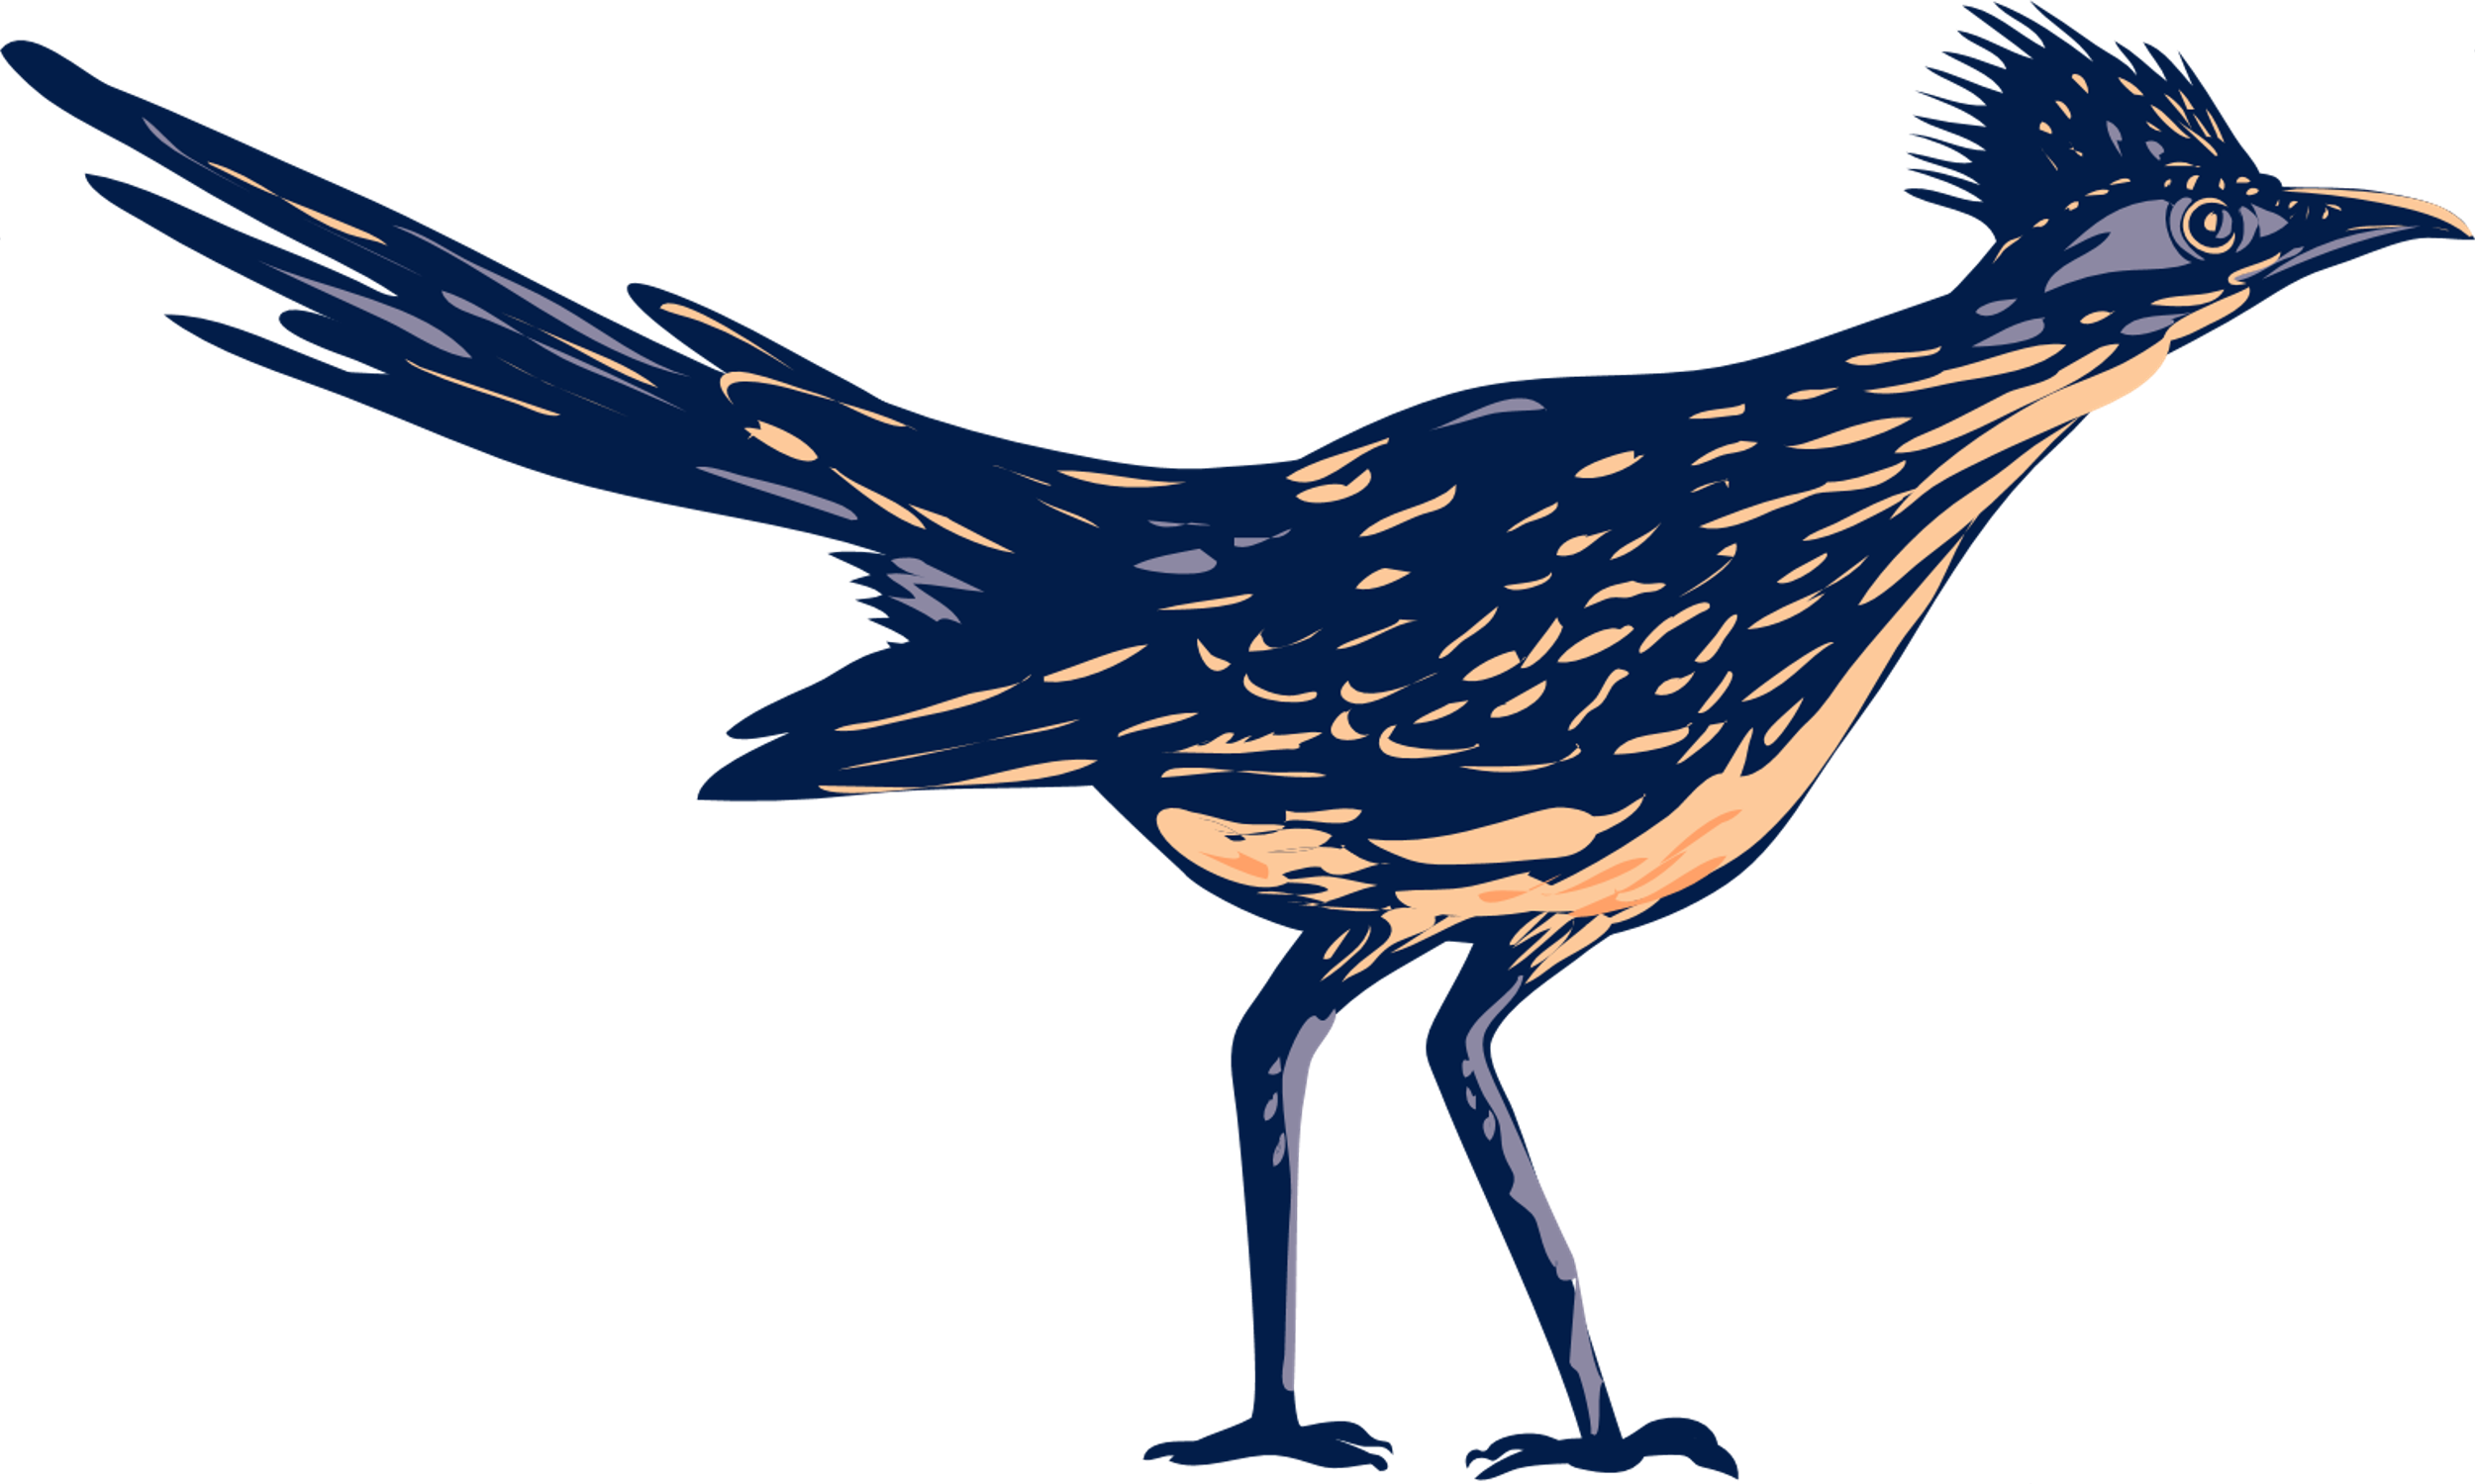
THANK YOU
Sources and Citations
All images besides diagrams were sourced from Canva.

